Slide 1
SHELL MOUNDS WHO OR WHAT MADE THEM?

Slide 2
This talk will feature:
Weipa shell mounds
The hypothesis of human origin
Coastal processes
Bird life
Cognitive dissonance

Slide 3
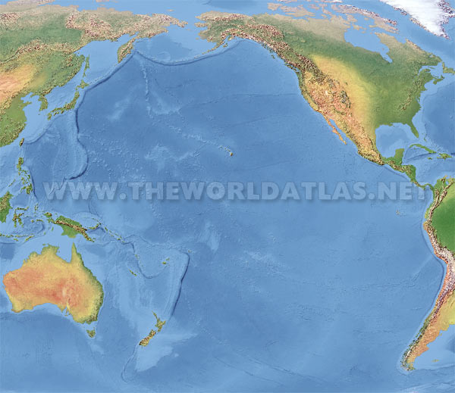

Slide 4
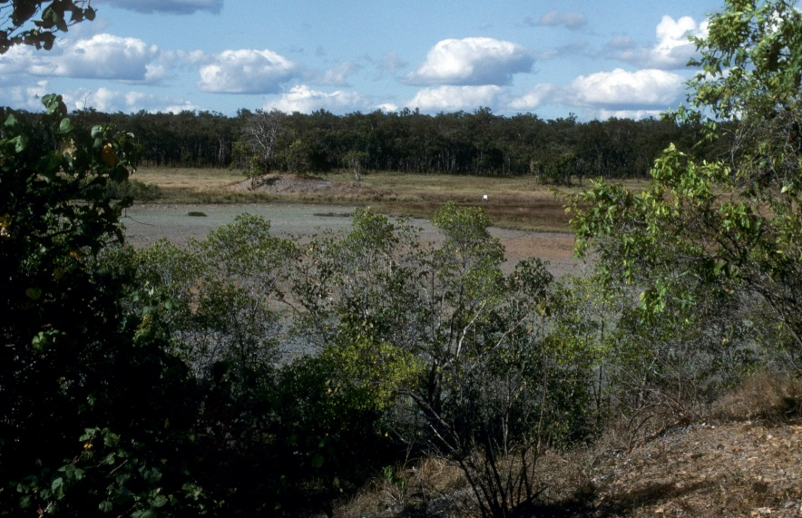
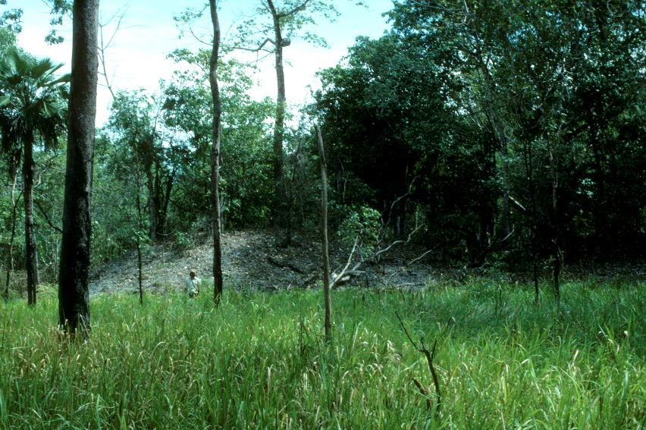
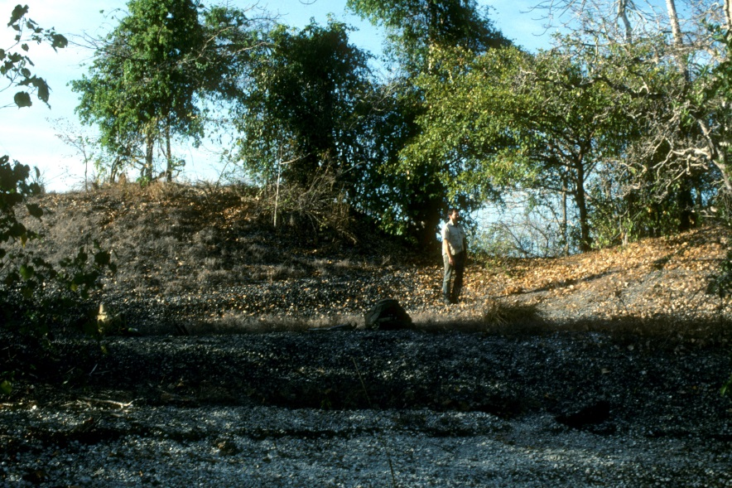
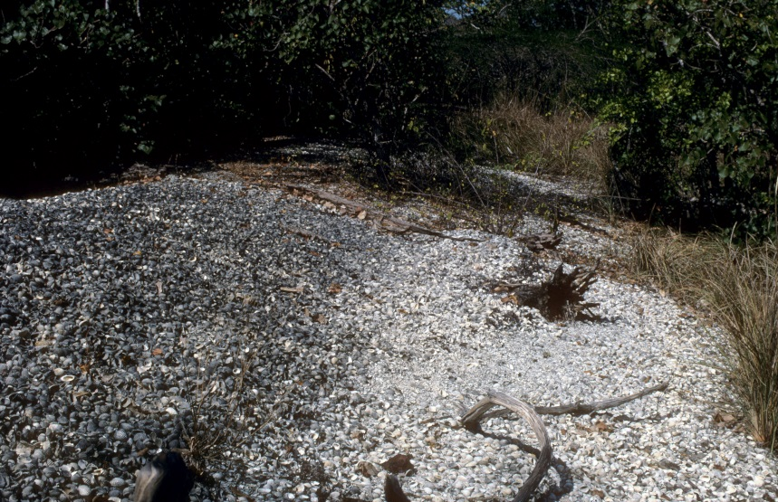
The Weipa shell mounds range in size from shell scatters to steep-sided conical mounds 13 metres high.

Slide 5
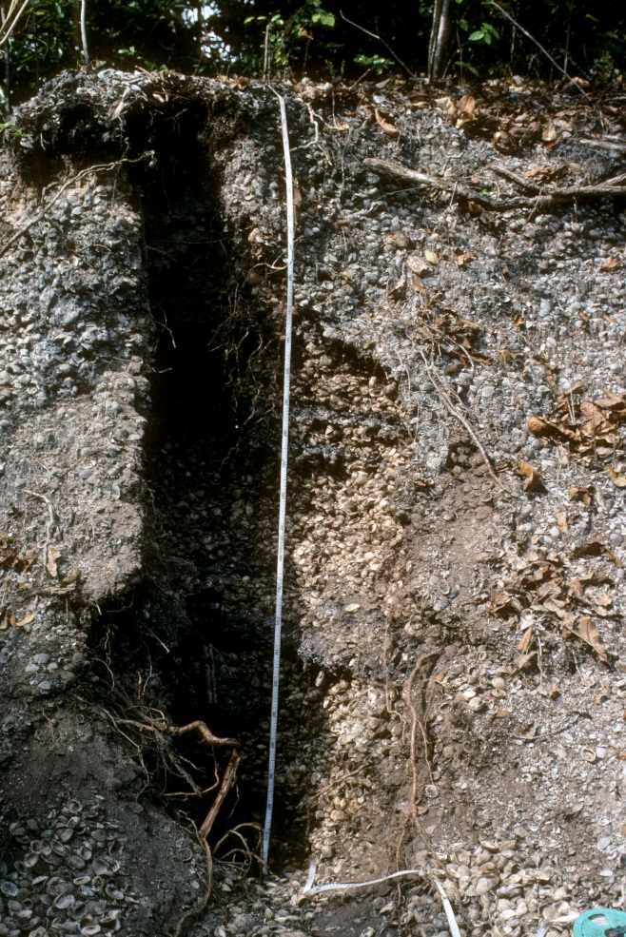
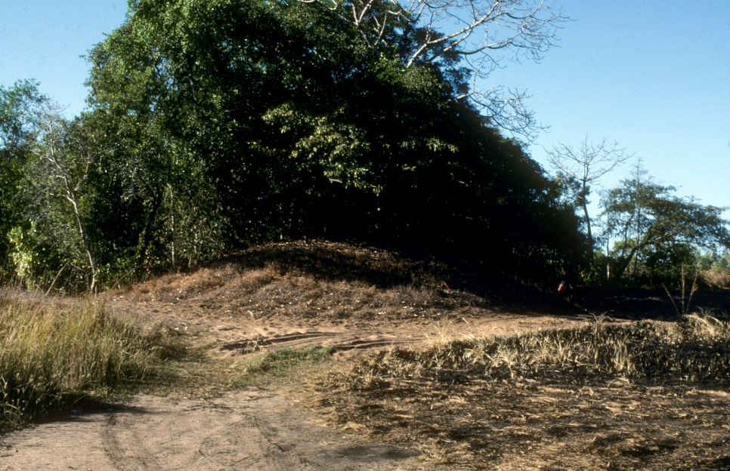
Composition is almost entirely Anadara granosa shell. The species is edible and farmed commercially in Malaysia
Strangely (and inconveniently), mounds of sand and gravel are also present in the coastal landscape

Slide 6
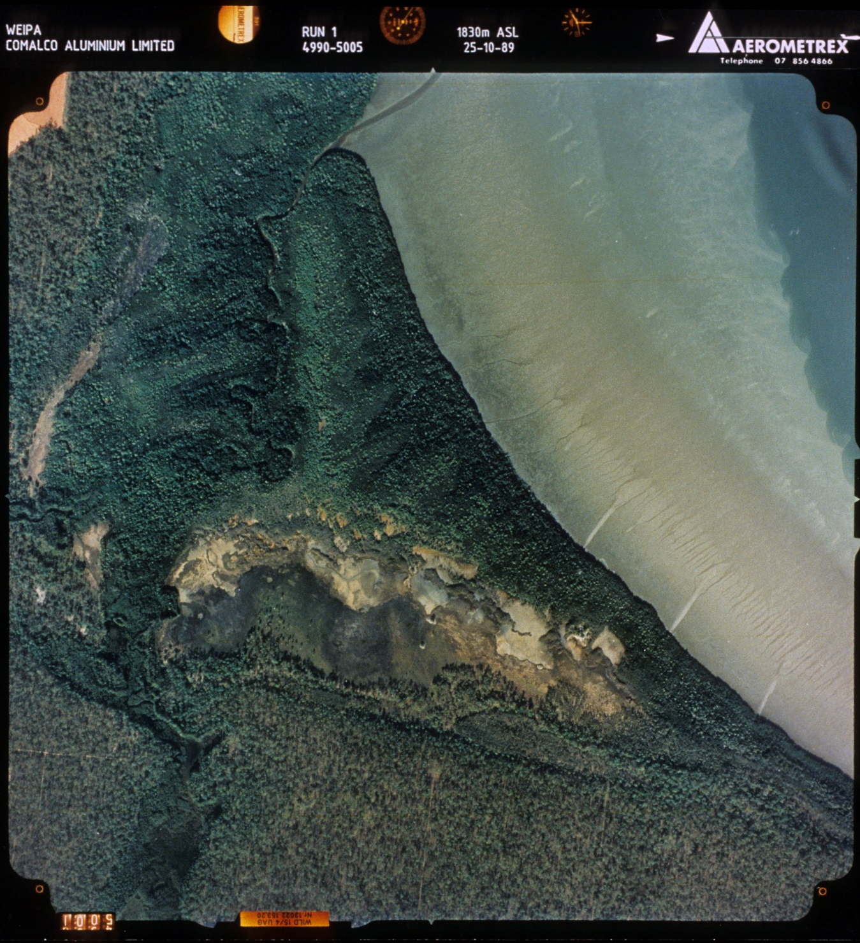
Setting is prograding coastal plains, beach ridges and gentle lateritic slopes at or slightly above sea level
r

Slide 7
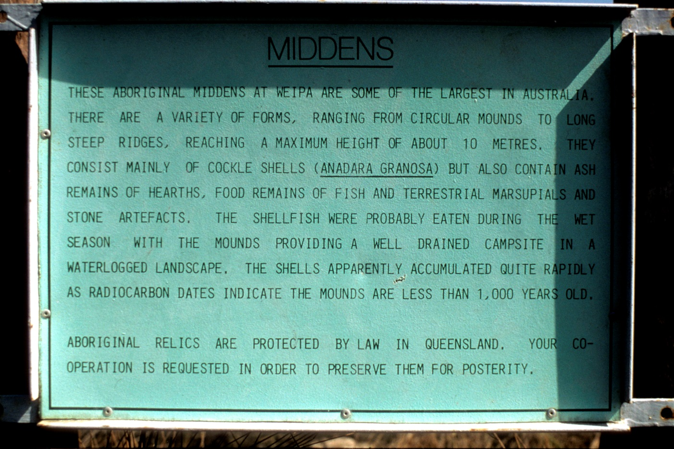
The hypothesis of human origin – shell middens!
Listed on the Register of the National Estate as among the world’s largest prehistoric middens

Slide 8
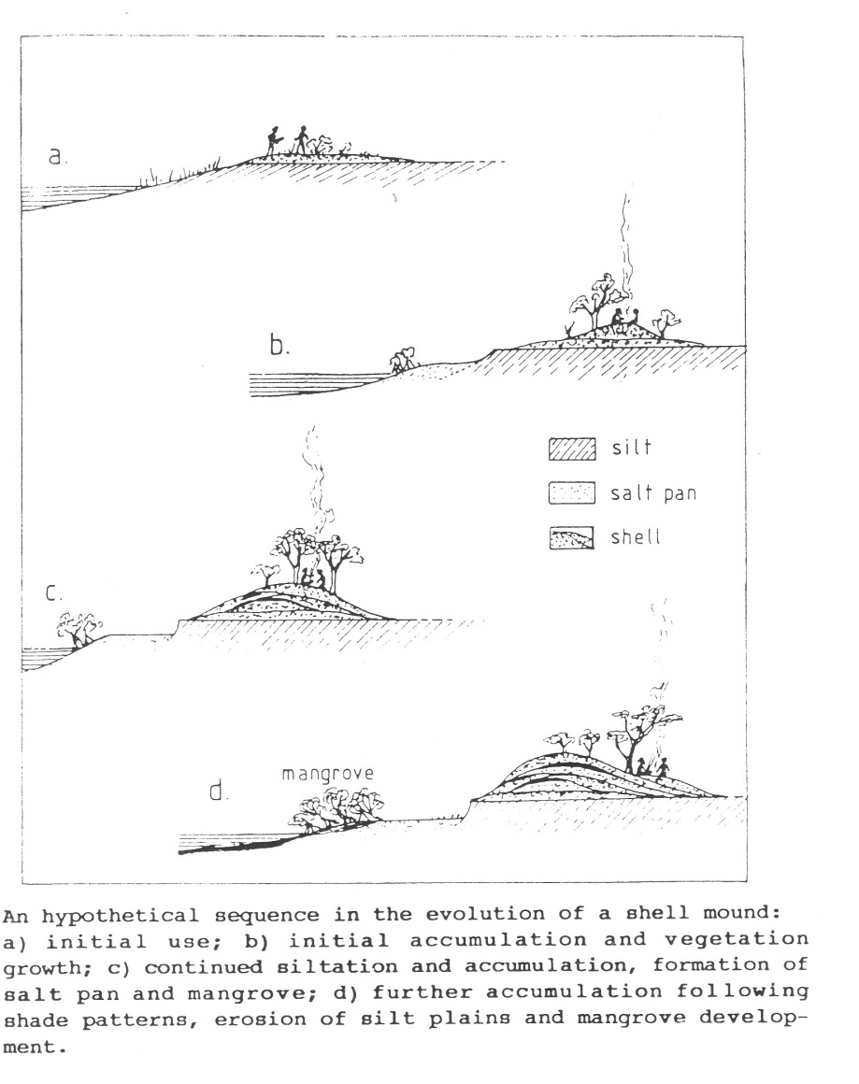
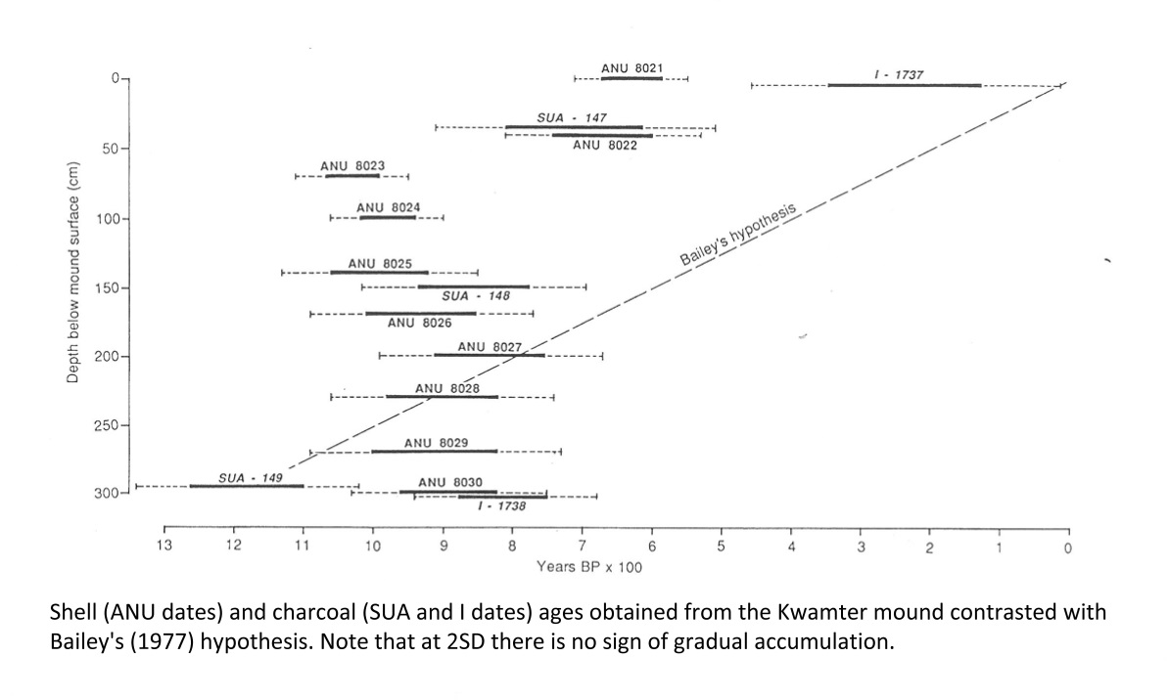
OK, Let’s test that
Oh dear…

Slide 9
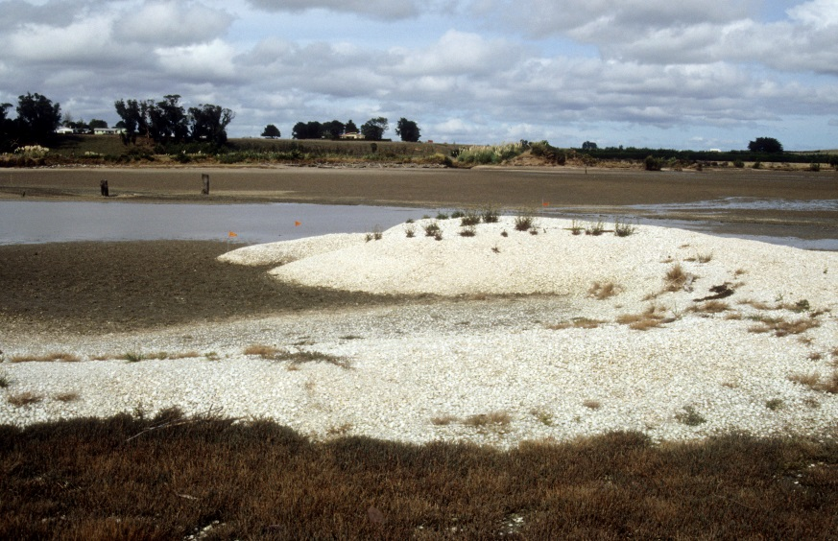
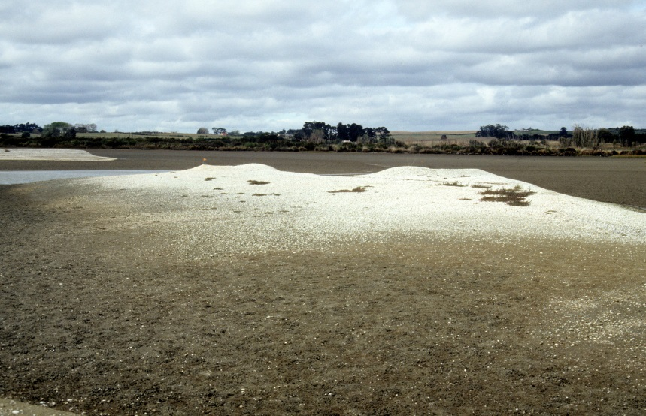
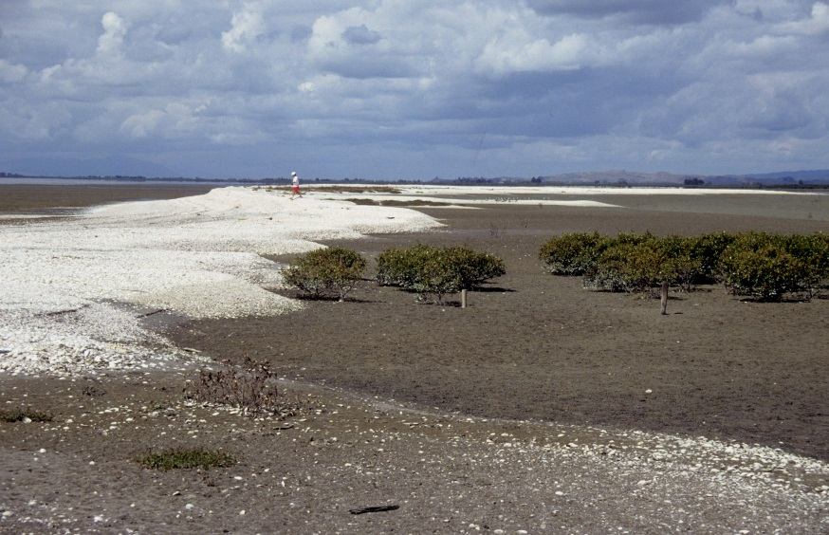
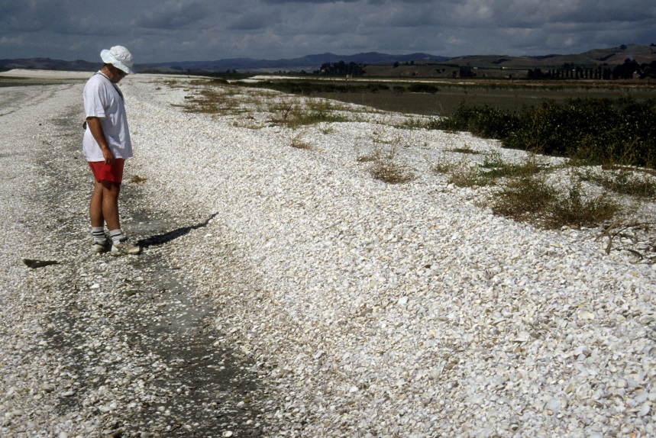
What is observable in coastal environments?

Slide 10
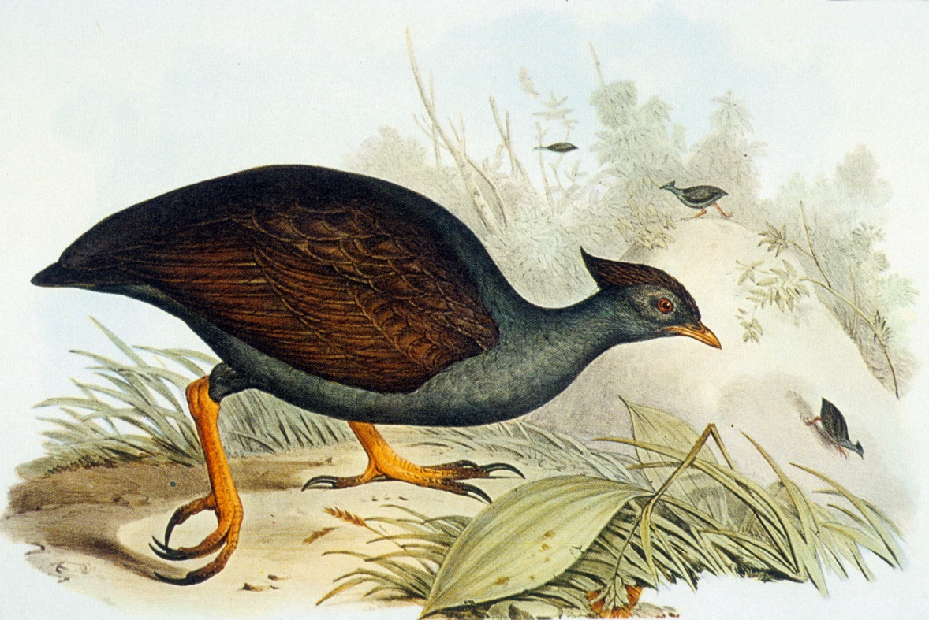
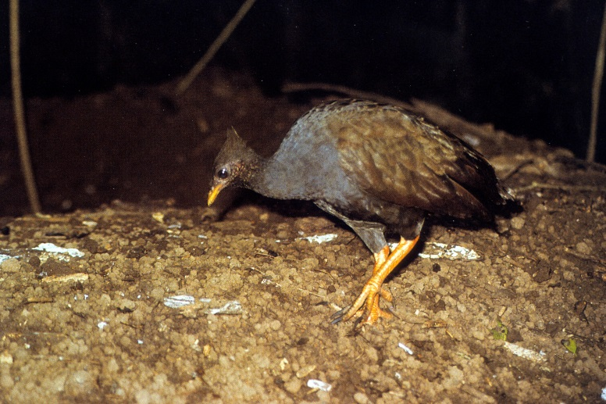
and in northern Australia in particular?
The Orange-footed Scrubfowl Megapodius reinwardt.

Slide 11
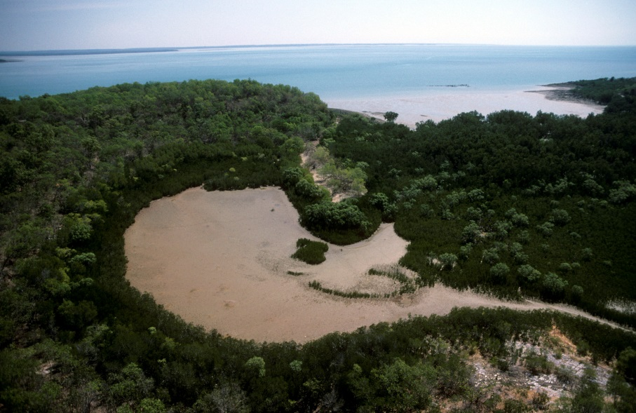
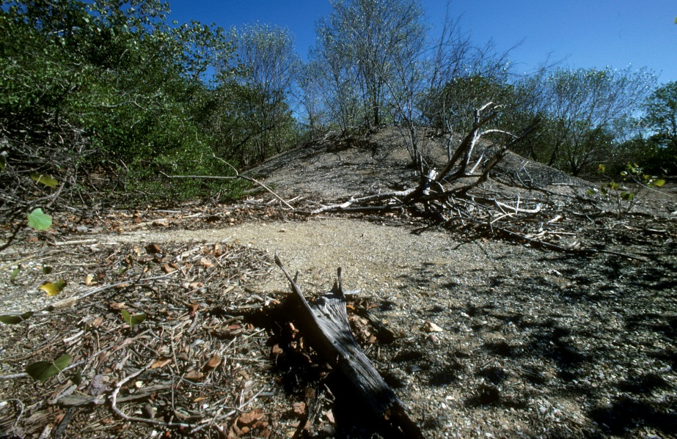
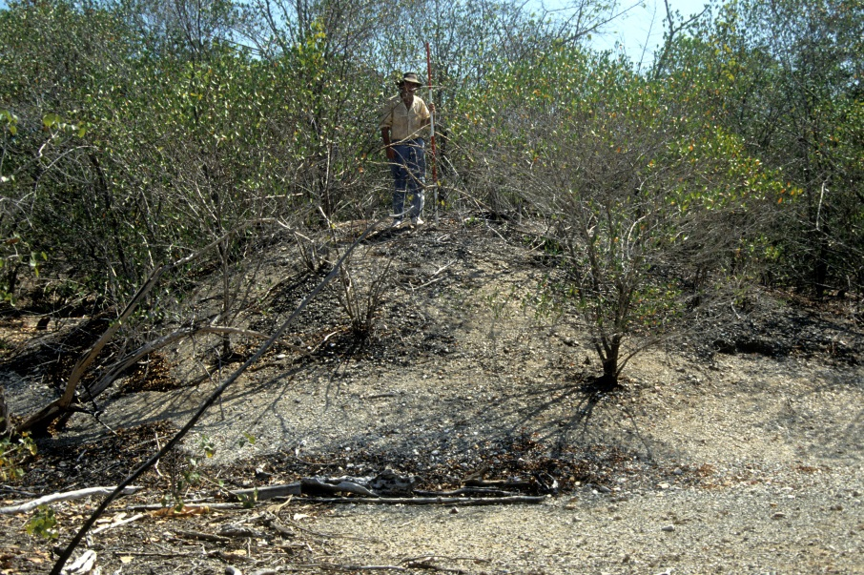
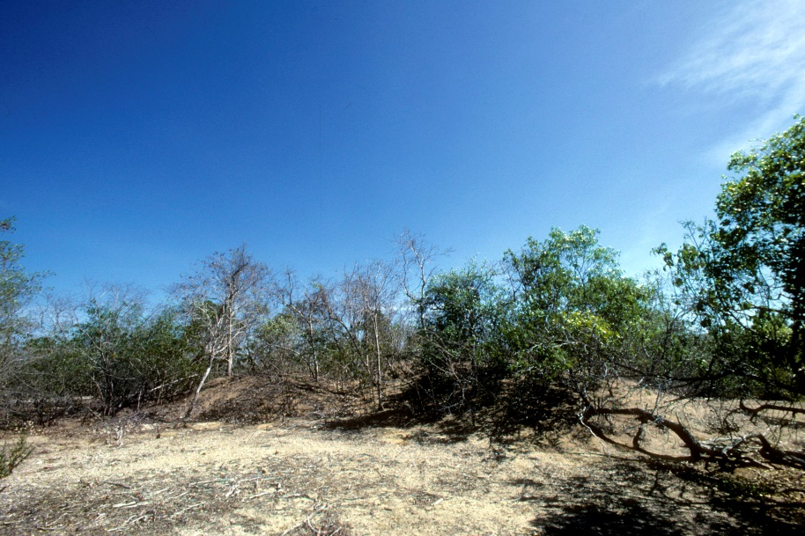
Darwin Harbour – dry season

Slide 12
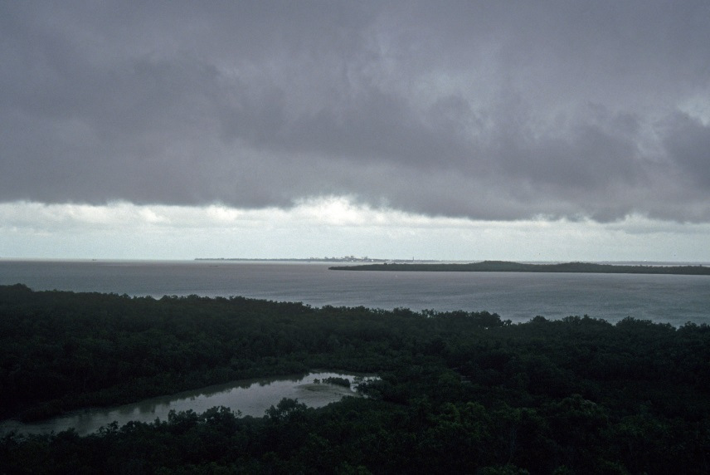
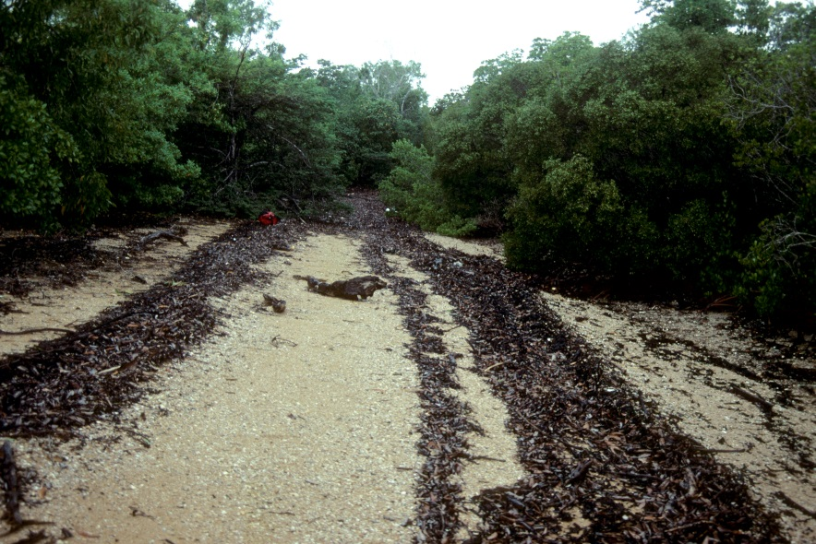
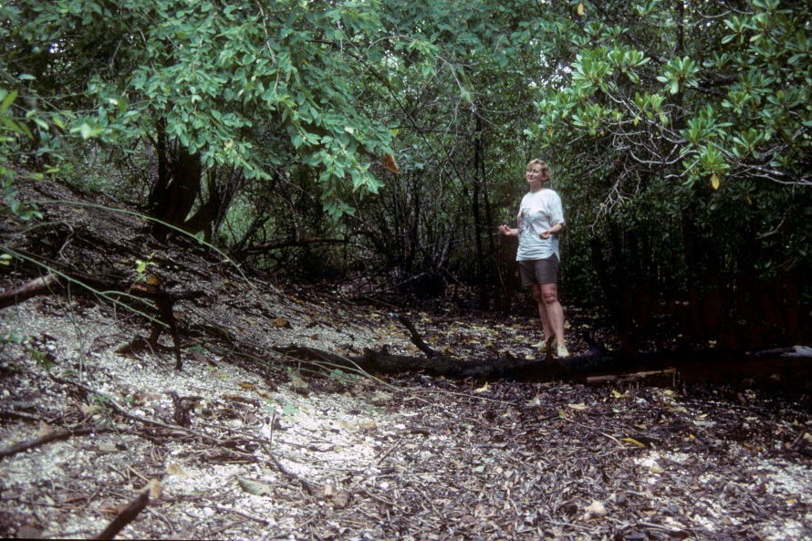
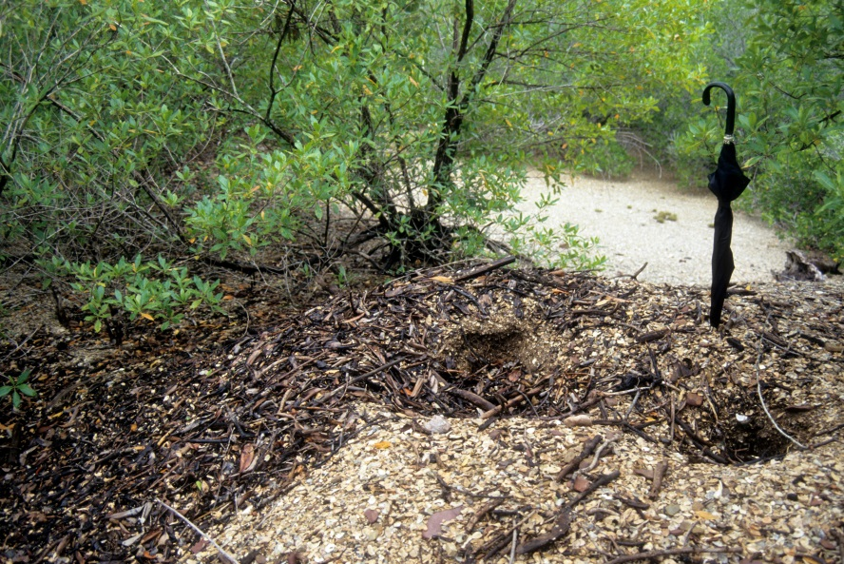
Darwin Harbour – wet season

Slide 13
Cognitive dissonance
Research demonstrating that the Weipa shell mounds are natural in origin was published in Marine Geology in 1995.
It remains a fact of archaeology in Australia that the mounds were built by humans.
Social theorists argue that the mounds are the result of ‘intensification’ i.e. human population pressure, sedentism and the inevitable switch to agriculture.
Ornithologists and palaeoecologists use the mounds to measure the rate of rainforest retreat and habitat decline in the face of climate change.
Archaeologists are awarded more higher degrees and funding to peddle pseudo-science than natural scientists who are blindly ignored.
Go figure…

Slide 14
Indiana University has a shell mound past
Sambaqui da Carnica, Brazil
From W. R. Hurt 1974 Occasional papers and monographs 1, Indiana University Museum, Bloomington

